Slide 1

CanAI Cafe
Data-Driven Insights & Revenue Forecast
Team A | CanAI Garage Hackathon | June 2026

Slide 2
Problem Statement & Objectives
CanAI Cafe handed us a year of messy transaction data — and one question: where is the business heading?
The Challenge
~10,000 records from 2023 — full of typos, nulls and inconsistencies
Clean it, understand it, and forecast 6 months of revenue
Turn raw data into decisions the cafe can act on
Three Deliverables
A clean, validated dataset with a full audit trail
Insights across products, regions, time and customer behavior
A 6-month revenue forecast with confidence intervals

Slide 3
Data Overview
After cleaning: 9,483 transactions across Jan–Dec 2023
$81,933
9,483
$8.64
8
Total Revenue
Transactions
Avg Transaction
Products · Bev/Food 50-50
5 Provinces British Columbia · Newfoundland & Labrador · Saskatchewan · Manitoba · Ontario
Channels In-store 59% · Takeaway 32% · Unknown 9%
Payments Credit Card 40% · Digital Wallet 30% · Cash 25% · Unknown 5%
A full calendar year — enough to detect weekly and monthly patterns, though not year-over-year trends.

Slide 4
Data Quality & Cleaning
The raw data was intentionally messy — here is what we found, and how we fixed it.
The Mess
1,243 item-name typos — “cofee”, “C0ffee”, “Sandwhich”, “Donutt”
3,421 province-name variants — abbreviations mixed with full names
84 duplicate Transaction IDs — dropped as a precaution
63 unparseable dates & error codes (e.g. “ERR_PM_102”)
Null values in 6 of 9 columns
What We Fixed
10,000 → 9,483 rows — 94.8% retained
Every typo mapped to a canonical name (5+ variants per product)
Remaining nulls filled “Unknown” — Payment 5.5%, Location 8.8%, Province 4.2%
Full cleaning audit log for full reproducibility
Dirty data leads to wrong conclusions — every insight that follows is built on a validated foundation.

Slide 5
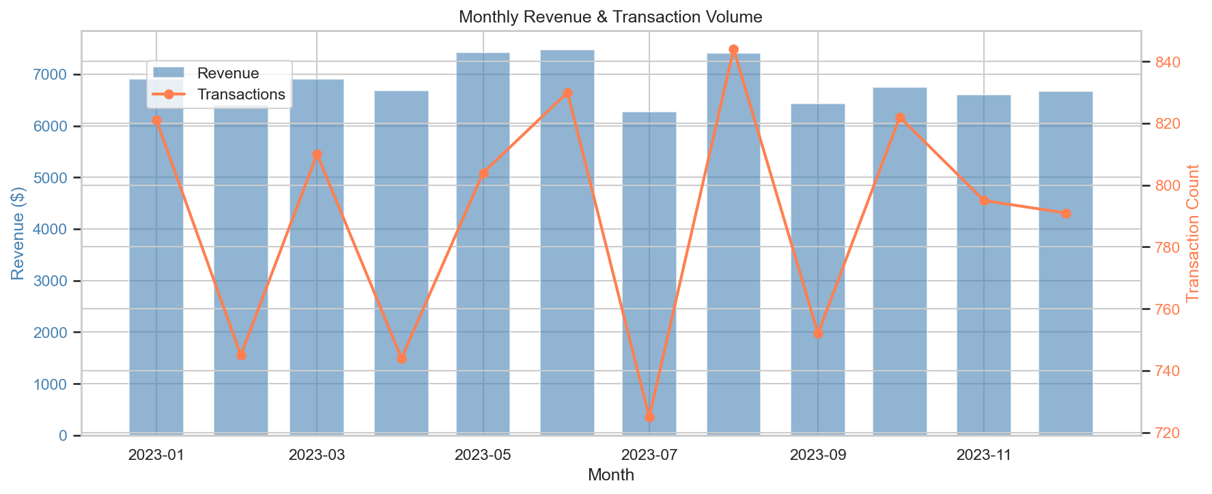
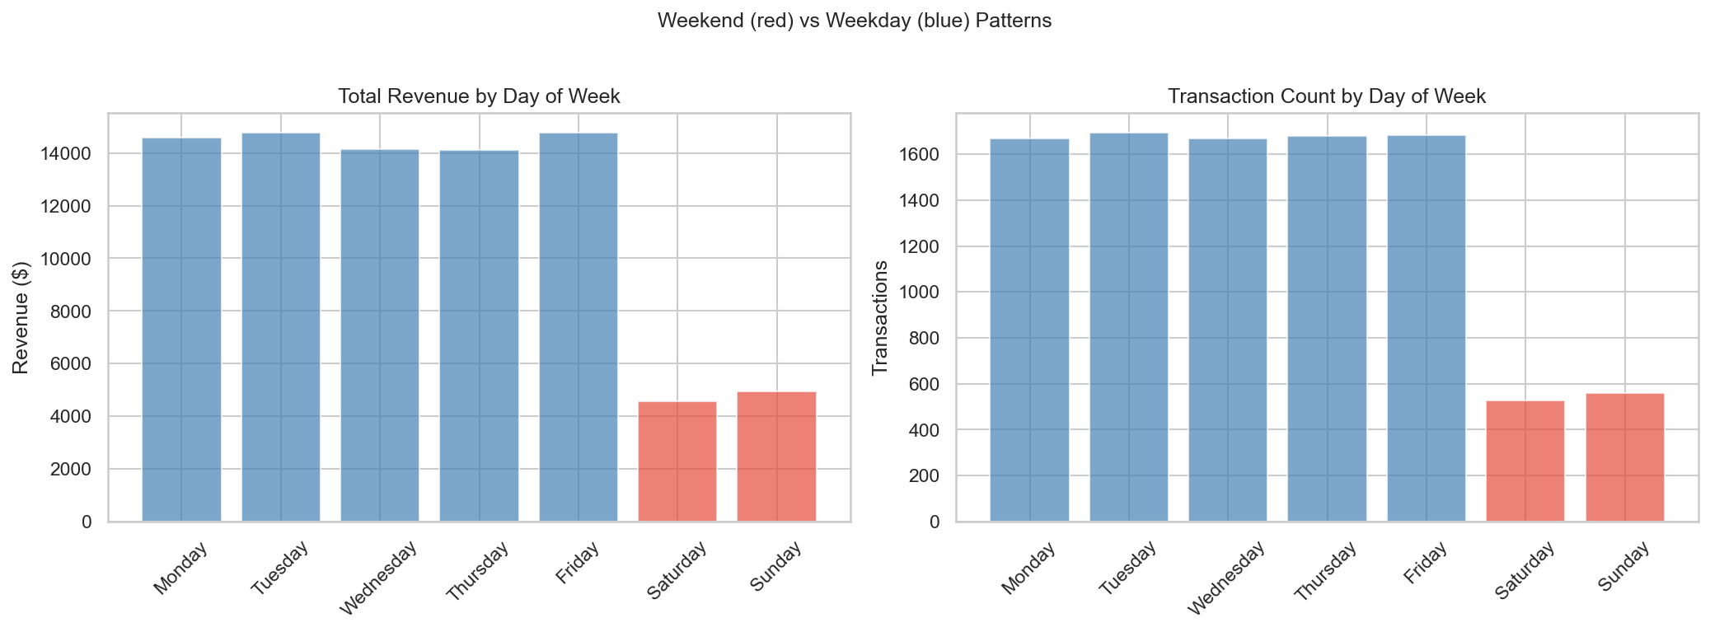
Sales Trends & Timing Patterns
Revenue is flat and stable all year — and the cafe is overwhelmingly a weekday business.
Monthly revenue & transactions
Revenue by day of week
Flat & stable — monthly revenue held a tight $6,268–$7,470 band (avg $6,828); no seasonality or trend
Weekday-driven — 88.6% of transactions land Mon–Fri; weekend visitors actually spend slightly more ($8.77 vs $8.62)
Dominant signal — a repeating 7-day weekly cycle (0.74 autocorrelation at lag 7)

Slide 6
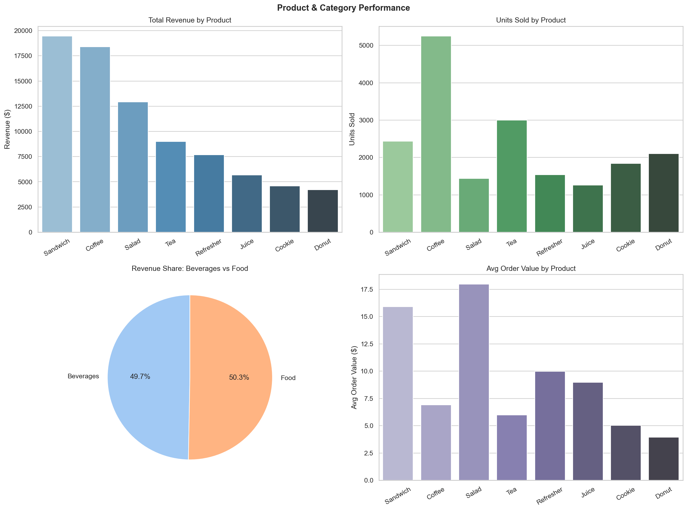
Product Performance
Product | Rev Share | Units | Avg Order
Sandwich | 23.8% | 2,434 | $15.91
Coffee | 22.4% | 5,254 | $6.91
Salad | 15.8% | 1,437 | $17.96
Tea | 11.0% | 2,997 | $5.99
Refresher | 9.4% | 1,538 | $9.97
Juice | 6.9% | 1,258 | $8.99
Cookie | 5.6% | 1,837 | $5.05
Donut | 5.1% | 2,102 | $3.94
Revenue, units & avg order by product
Coffee leads on volume (5,254 units); Sandwich leads on revenue at $15.91 vs $6.91 per order
Salad is the premium item — $17.96 avg order, fewest transactions
Beverages & Food split revenue ~50/50; bottom three products are just 17.6%

Slide 7
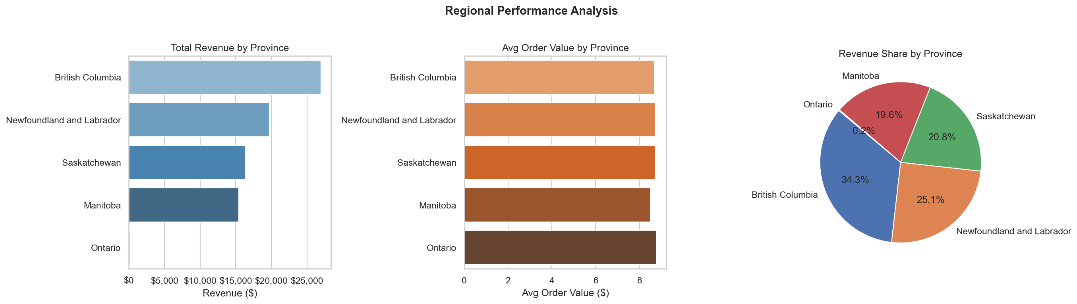
Regional Performance
Same spending everywhere — BC's lead is about traffic volume, not bigger baskets.
Total revenue · avg order value · revenue share by province
Province | Revenue | Share | Transactions | Avg Order
British Columbia | $27,000 | 34.3% | 3,114 | $8.67
Newfoundland & Labrador | $19,709 | 25.1% | 2,260 | $8.72
Saskatchewan | $16,355 | 20.8% | 1,876 | $8.72
Manitoba | $15,457 | 19.6% | 1,819 | $8.50
Ontario | $158 | 0.2% | 18 | $8.78

Slide 8
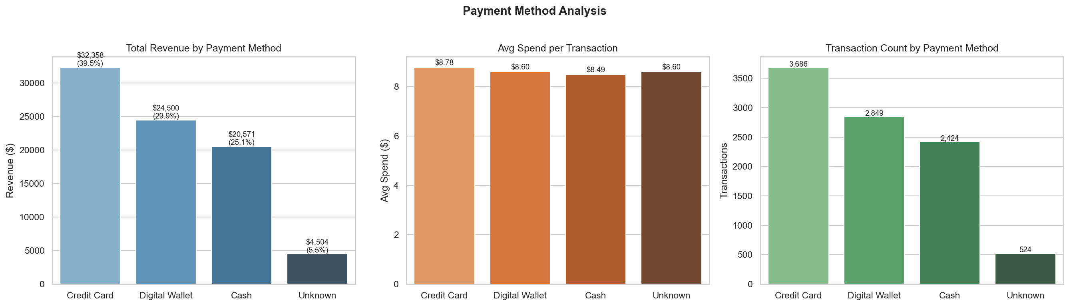
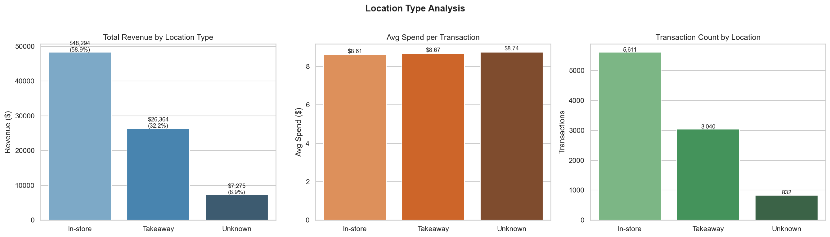
Channel & Payment Insights
Average spend barely changes across channels or payment methods — revenue is a traffic story.
Channel mix
In-store 59% — $48,294
Takeaway 32% — $26,364
Steady 1.8 : 1 ratio in every province
Payments
~70% cashless: Credit 39.5% + Wallet 29.9%
Cash 25.1% — $20,571
Uniform spend
$8.49–$8.78 average across all methods
Payment method analysis
In-store vs takeaway

Slide 9
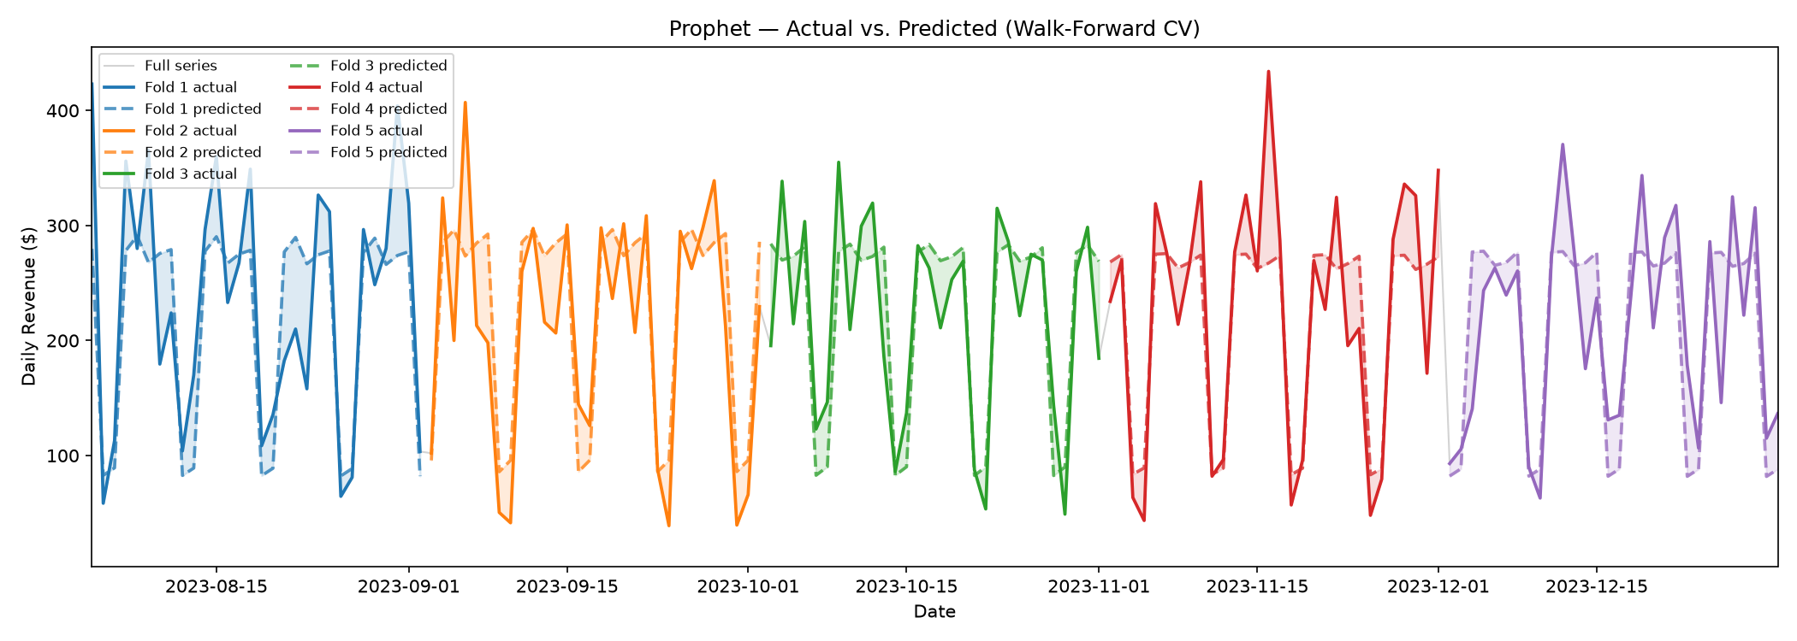
Forecasting Methodology
Two models, rigorously validated with walk-forward cross-validation — and a clear, defensible winner.
What we did
Aggregated to daily total revenue (365 points)
Tested two models: Prophet and SARIMA
Walk-forward CV: 5 folds, 30-day test windows
Every run tracked in MLflow for reproducibility
Walk-forward CV — actual vs. predicted (5 folds)
Metric | SARIMA | Prophet
MAPE | 25.84% | 25.89%
MAE | $44.35 | $44.06
RMSE | $55.76 | $55.44
Winner: SARIMA(0,1,1)(0,1,1)[7]
The “airline model” — chosen for the dominant 7-day weekly cycle. Tuning cut MAPE from 30.5% to 25.8%.

Slide 10
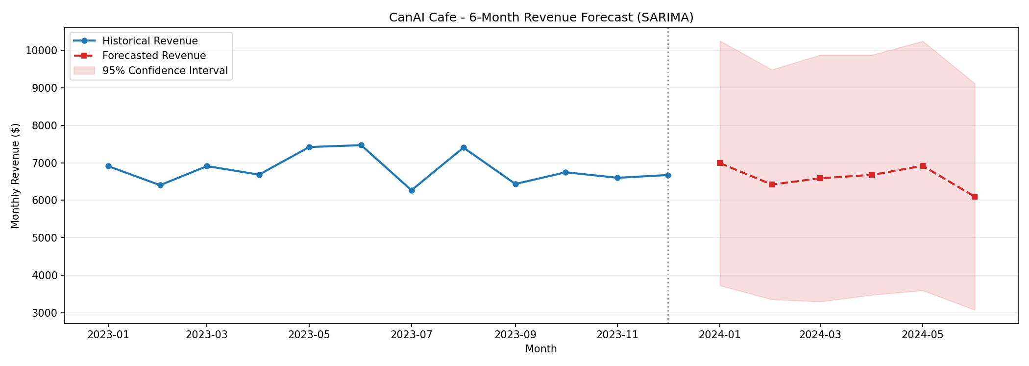
6-Month Revenue Forecast
Projected ~$6,600 per month through June 2024 — essentially flat, because the history is flat.
Month | Forecast | 95% Confidence Range
January 2024 | $6,991 | $3,729 – $10,254
February | $6,421 | $3,357 – $9,485
March | $6,589 | $3,299 – $9,879
April | $6,679 | $3,479 – $9,879
May | $6,920 | $3,596 – $10,245
June | $6,099 | $3,078 – $9,119
6-Month Total | $39,698 | —
6-month forecast with 95% confidence bands
The bottom line
≈ $6,600/month → ~$79,400 annualized
vs. 2023's actual $81,933 — only a ~3% difference
Both models agree: steady state, no growth or decline

Slide 11
Interactive Dashboard
Live Demo
Power BI dashboard · 5 analytical pages
Sales Overview
Regional
Product
Forecast
Recommendations
KPI cards & monthly trends
Province breakdown & geographic comparison
Mix & category performance
6-month projection with confidence bands
Data-backed action items

Slide 12
Recommendations
Five data-backed moves — each tied directly to what the numbers show.
1
Protect Sandwich & Coffee
46% of revenue sits in two products — secure supply and give them prime placement.
2
Staff for weekdays, experiment on weekends
89% of transactions are Mon–Fri. Align labor & stock, then test weekend offers.
3
Grow BC, investigate SK & MB
BC's 34% share is foot traffic, not bigger baskets — probe the ~19% provinces for upside.
4
Push further on digital payments
70% already cashless — negotiate lower processing rates on the 39.5% paid by card.
5
Treat stability as an asset
Flat ~$6,600/mo is predictable; growth will require deliberate new demand.

Slide 13
Conclusion & What's Next
What we delivered
Cleaned 10,000 → 9,483 validated records (94.8%) with a full audit trail
Profiled the business: weekday, in-store, sandwich-&-coffee, BC-centered
6-month SARIMA forecast: stable ~$6,600/mo, walk-forward validated
Interactive Power BI dashboard (5 pages), every run logged in MLflow
What more data would unlock
2+ years → year-over-year trends and annual seasonality
External data (weather, promotions, events) → explain the 42% of daily variation still unexplained
Product- and region-level forecasting, beyond today's aggregate view
CanAI Cafe is a stable, weekday-driven business earning ~$82K/year — growth will require deliberate moves on weekends, regions, or product mix.

